Slide 1
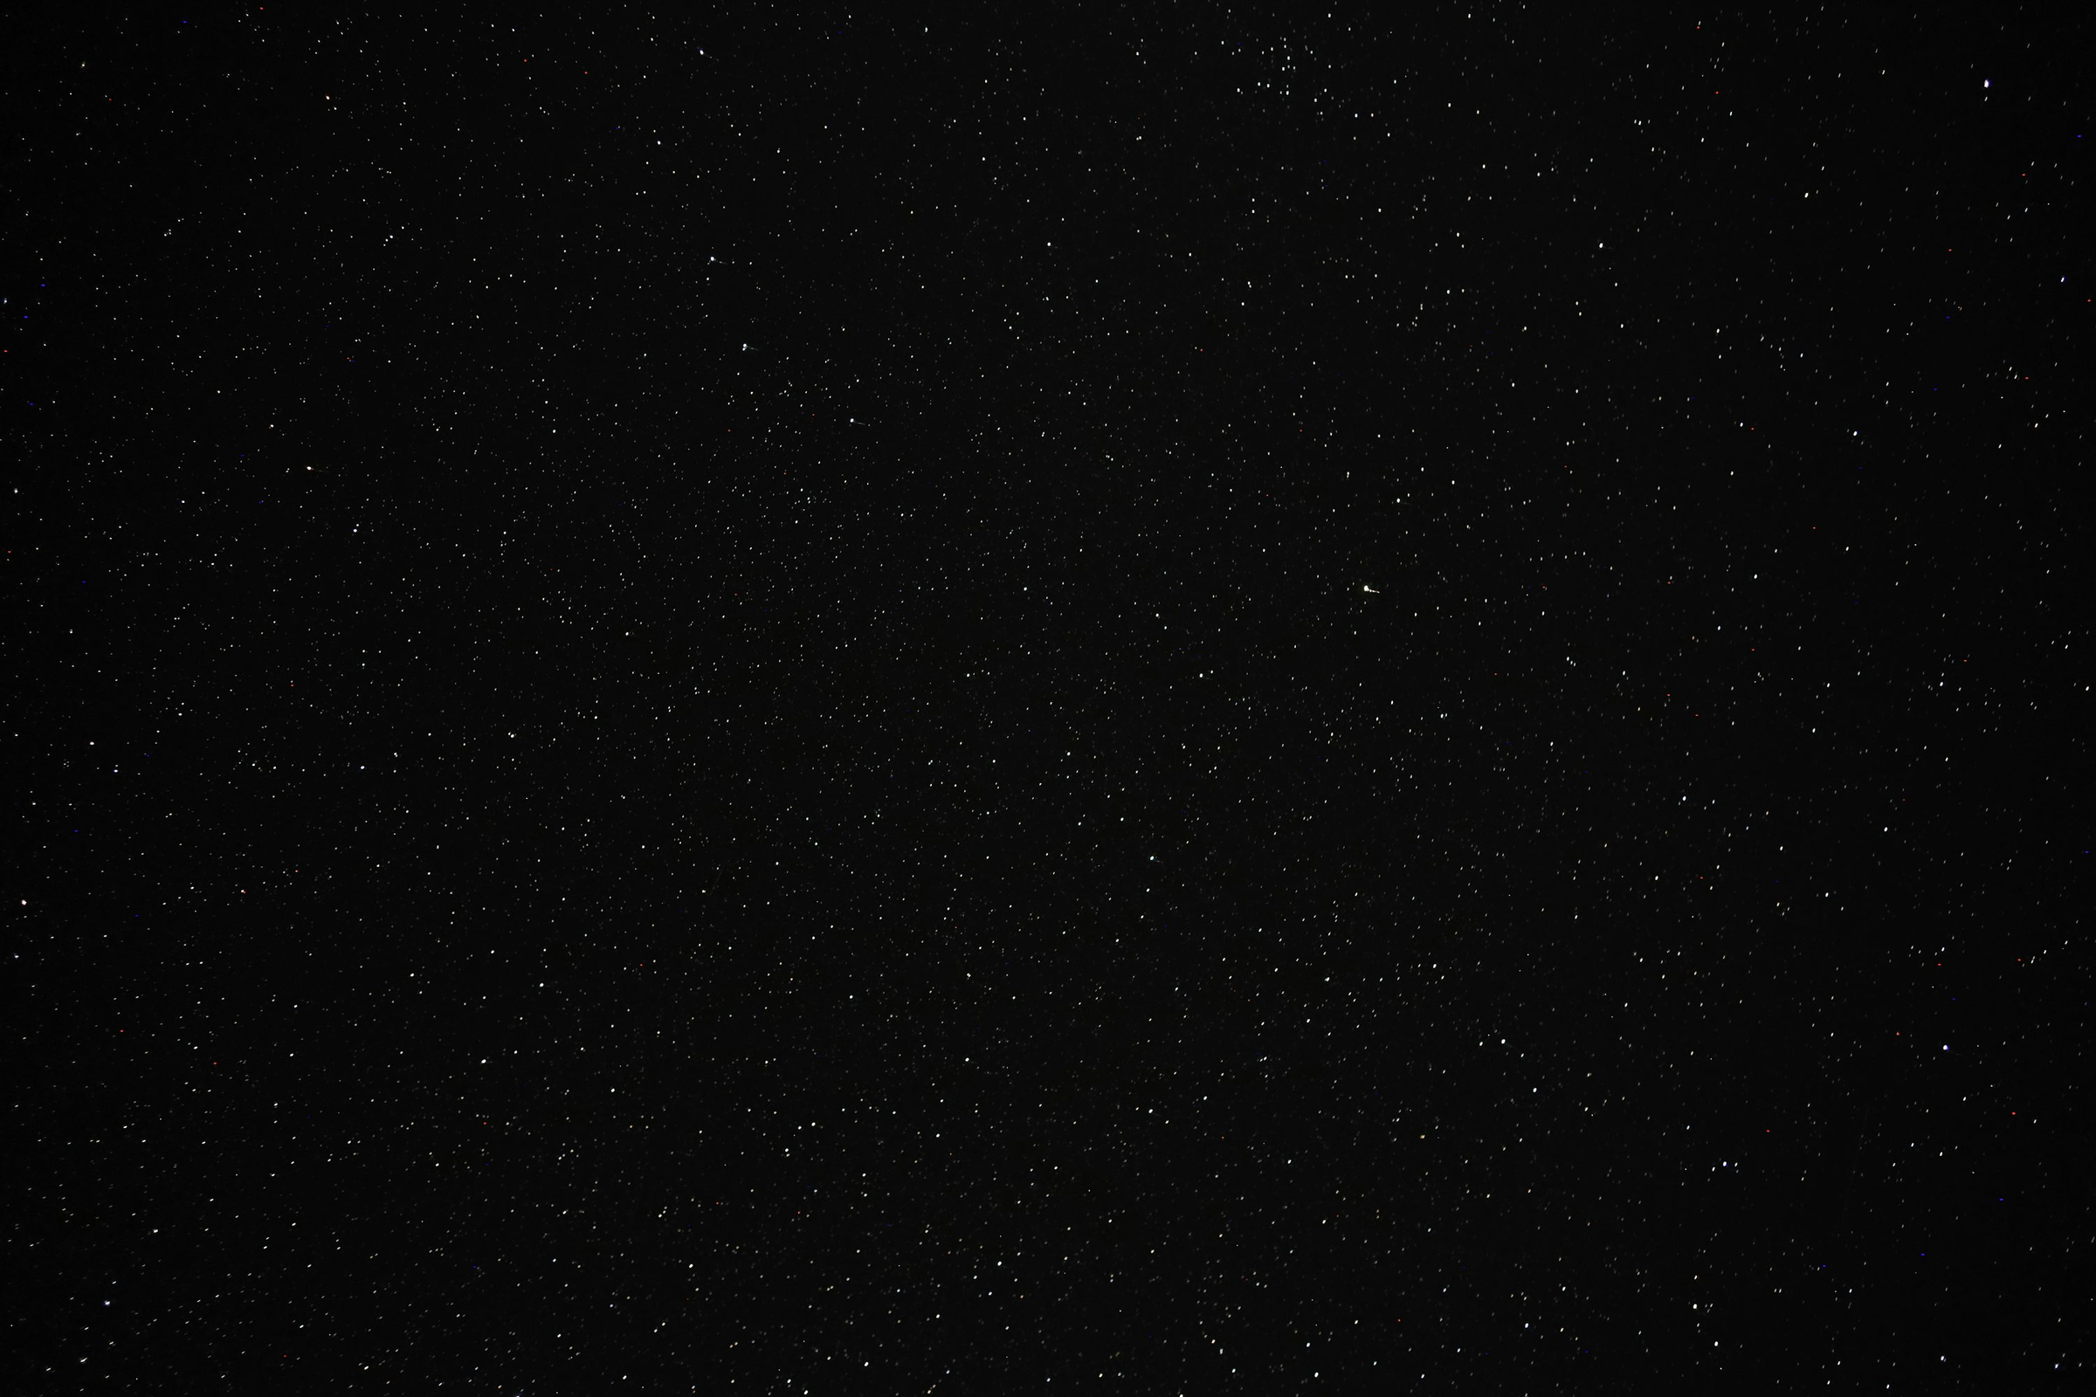

What happens with the alpha-elements in the Magellanic Clouds:
A study of the LMC and SMC using simulations in TNG50
José Fuentes, Elisa Pérez, Lucas Calbullanca,
Diego Ramírez, Tatiana Castillo,
Adonis Bustamante, Matias Almonacid

Slide 2
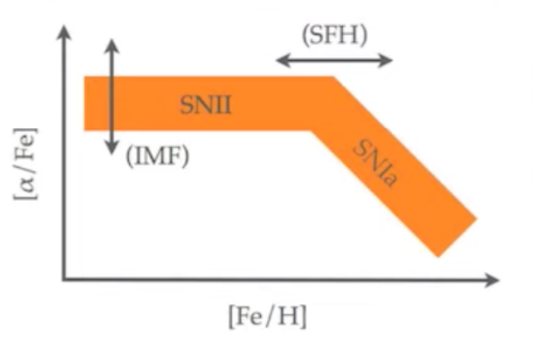
Introduction: The α-elements abundance plot
Source: ASTF510: Astrofísica Estelar Avanzada, 1er sem/2024, prof. Bruno Dias

Slide 3
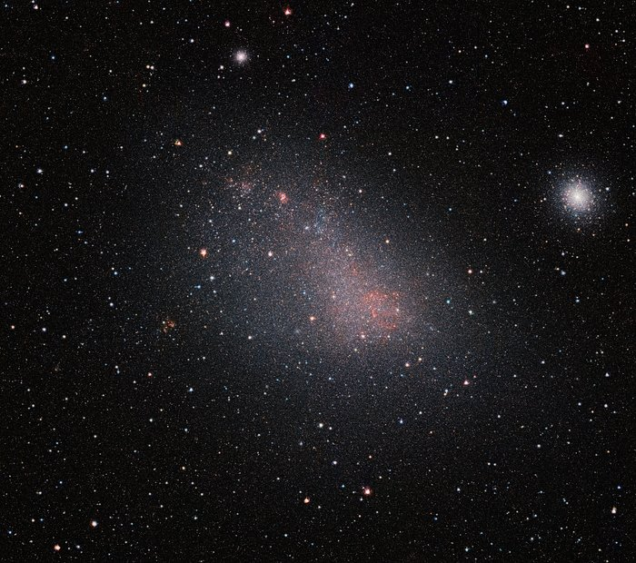
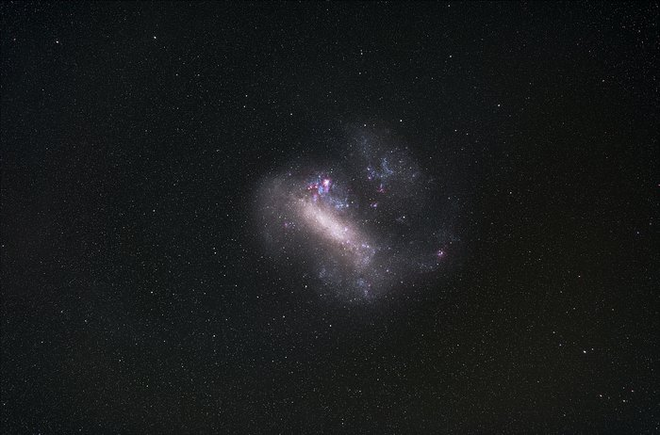
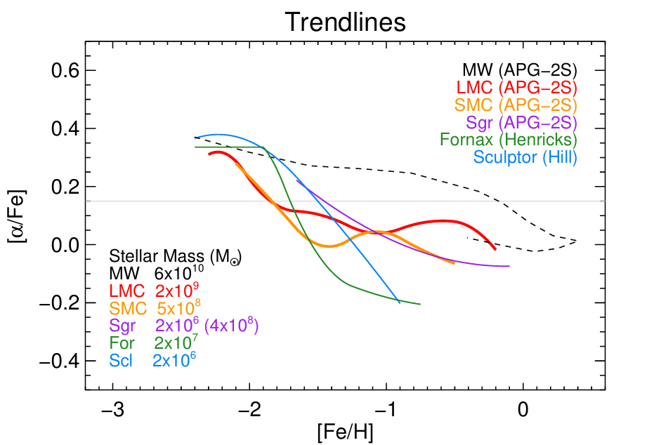
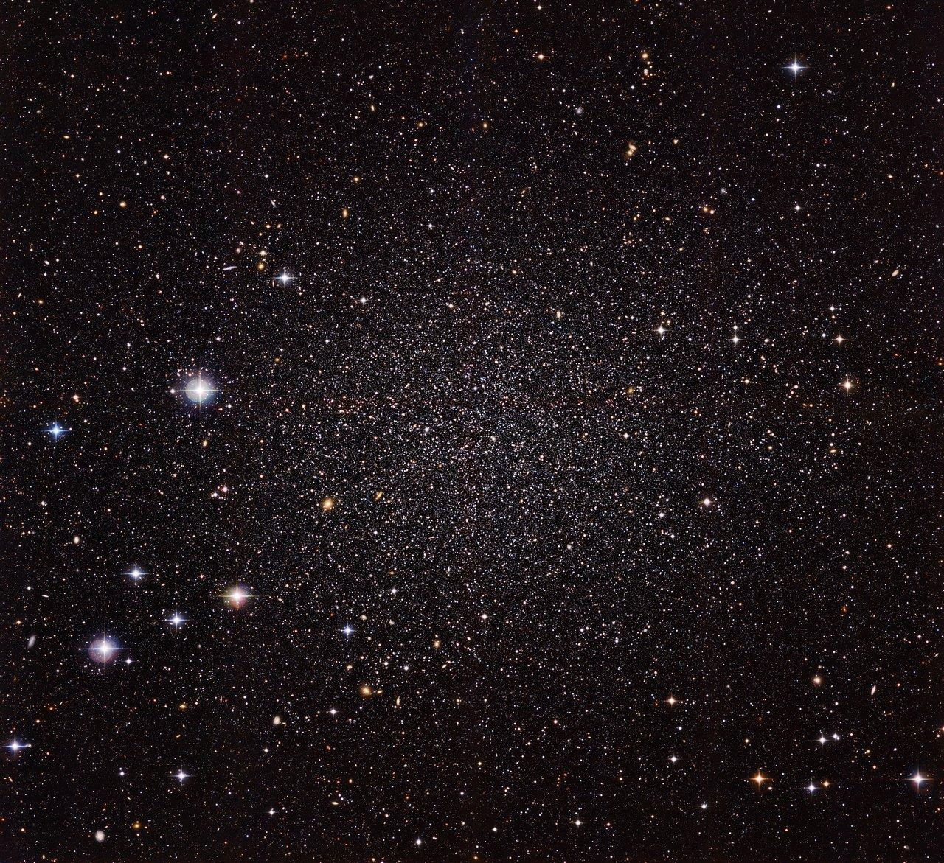
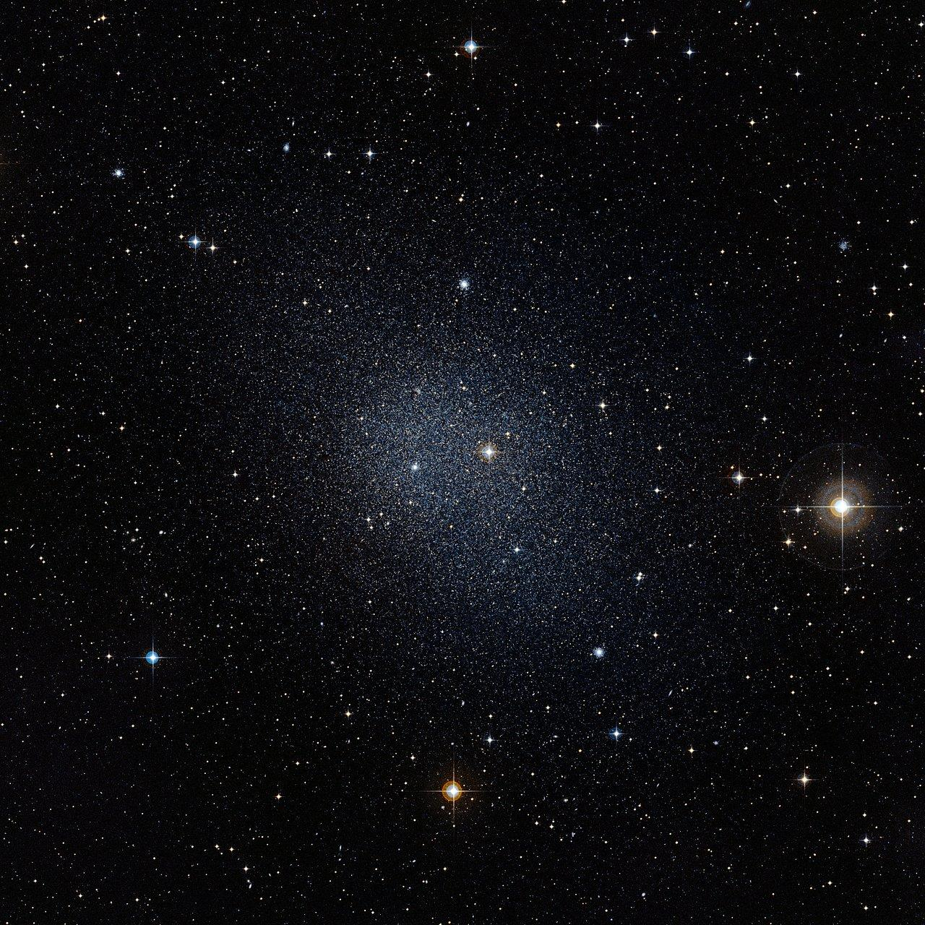
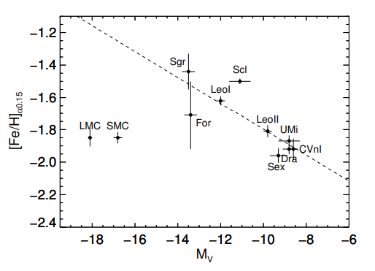
The problem with the Magellanic Clouds
SMC
LMC
Source:
ESO/VISTA VMC
eso.org
Source:
ESO/Zdeněk Bardon (http://www.bardon.cz/en/)
Sculptor
Fornax
Source: Nidever, D. et al (2020)
Source: MPG/ESO
eso.org
Source: ESO/Digitized Sky Survey 2
eso.org

Slide 4
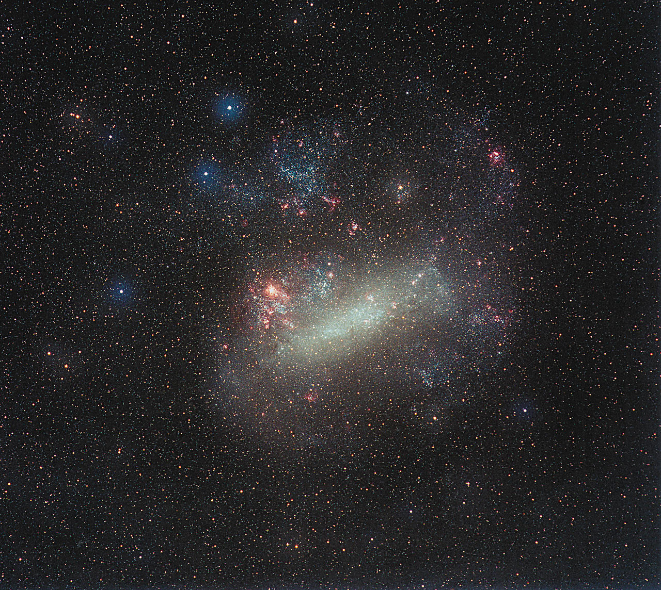
LMC Properties
The LMC has a stellar mass around 10^{9.43} M☉ (Shipp et al. 2020)
The 𝛼-element knee is at [Fe/H] ≈ -2.2, lower than others less massive Milky Way dwarf galaxies, and it has a low SFE ≈0.01 Gyr⁻¹. This low value suggest that the LMC was formed in a lower density environment (Nidever et al. 2020).
Source: Eckhard Slawik / ESA/Hubble
(https://esahubble.org/images/heic0411d/)

Slide 5
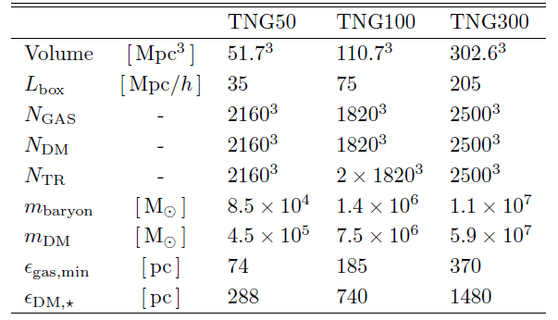
IllustrisTNG: High Resolution Cosmology Simulations
What is IllustrisTNG?
Main Simulations
Technology and computational methods
Source: IllustrisTNG Project, https://www.tng-project.org/about/

Slide 6
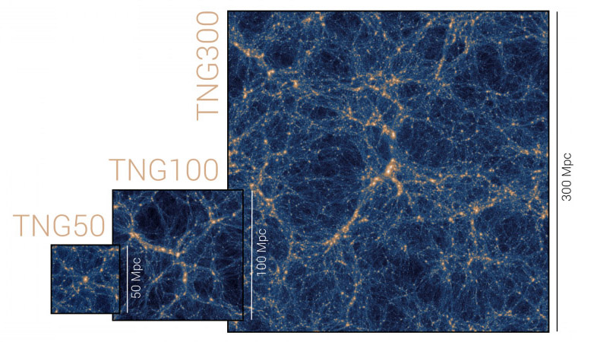
Why use TNG50 simulation?
Detailed studies of individual galaxies
Stellar formation and evolution
Interaction with supermassive black holes
Observational predictions
Dark matter distribution
Source: IllustrisTNG Project, https://www.tng-project.org/about/

Slide 7
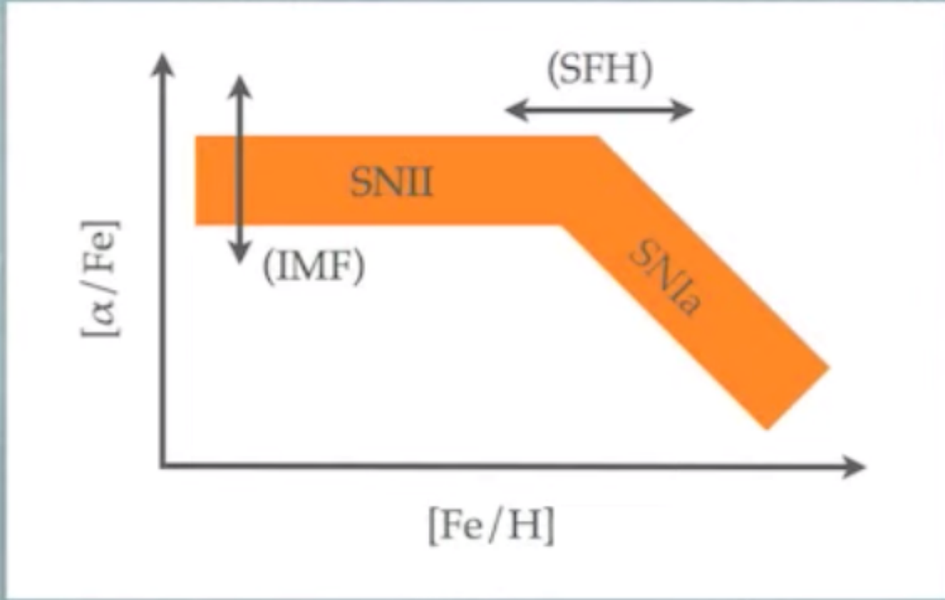
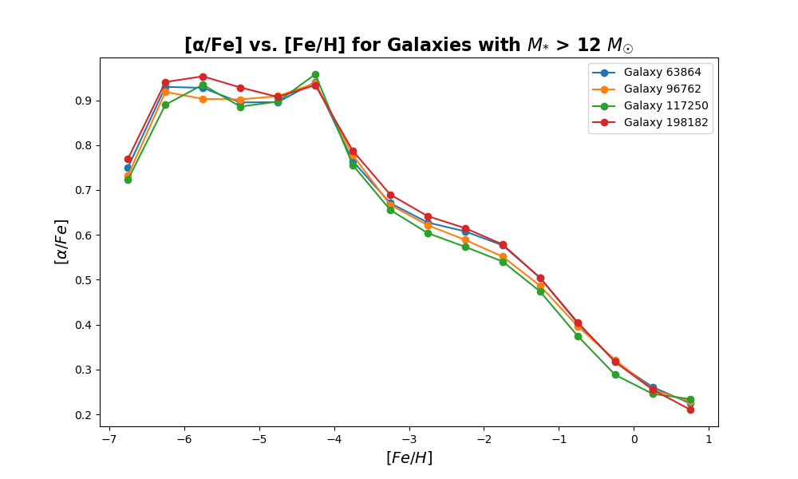
The α-elements abundance plot in TNG50
Source: ASTF510: Astrofísica Estelar Avanzada, 1er sem/2024, prof. Bruno Dias
SFE; star formation rate divided by gas mass

Slide 8
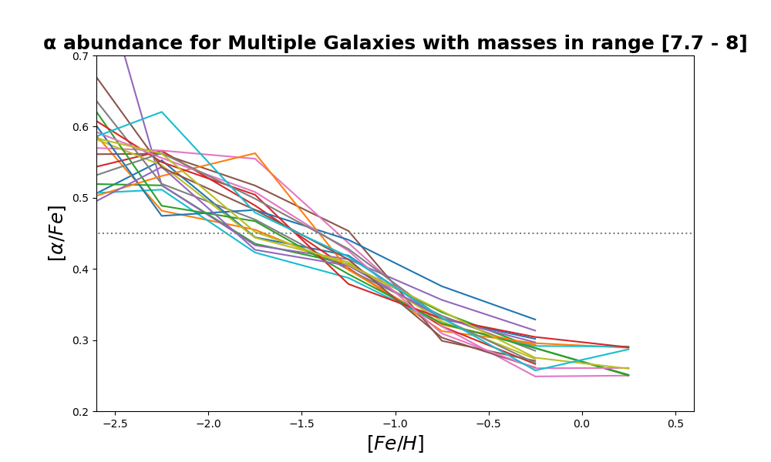
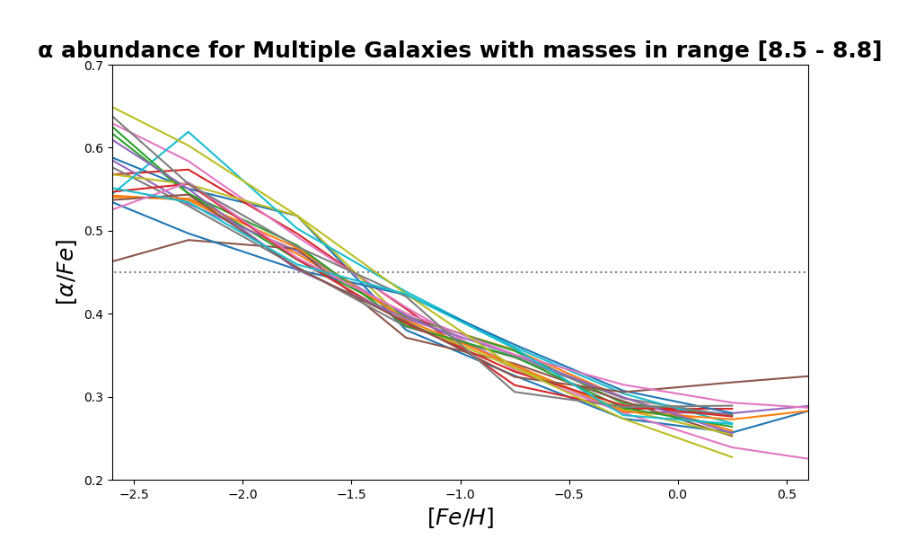
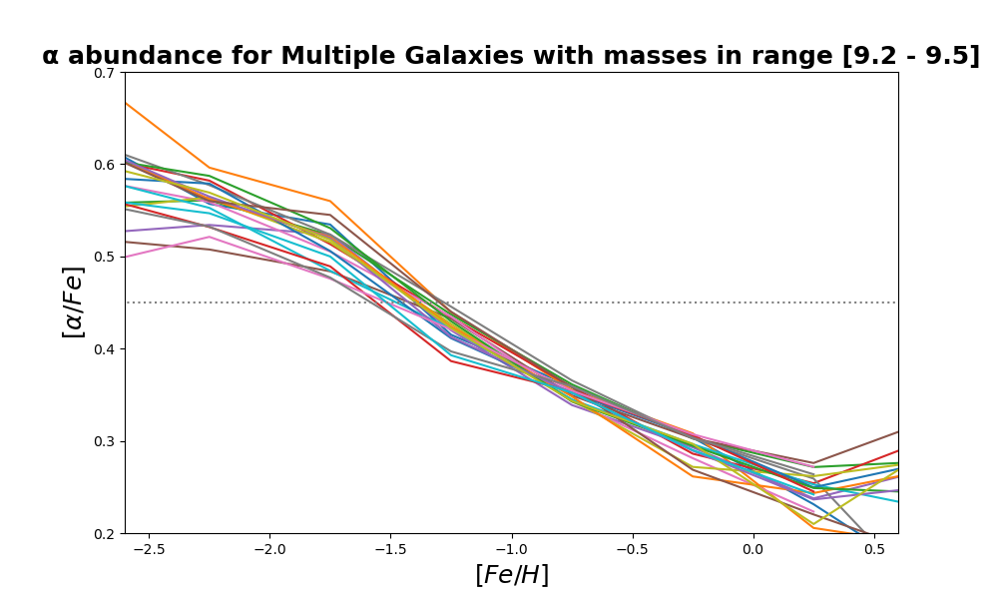
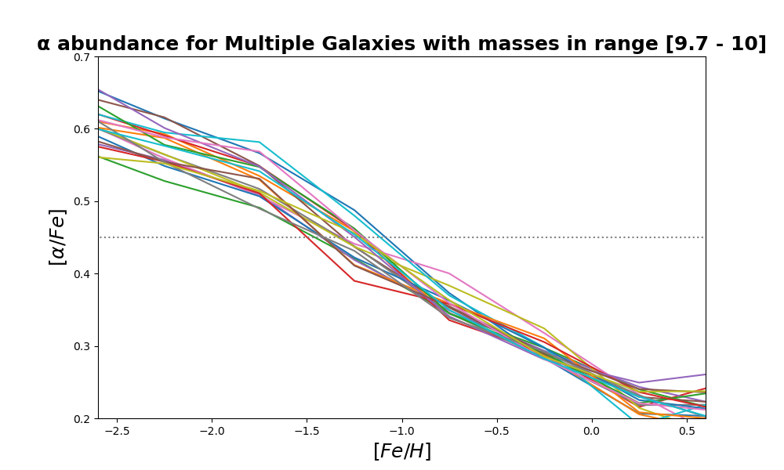
α abundance for different dwarf Galaxies
α = 0.45
Range (logM⋆[M☉]) | Nº Galaxies
7.7 - 8 | 1.663
8.5 - 8.8 | 1.162
9.2 - 9.5 | 675
9.7 - 10 | 394

Slide 9
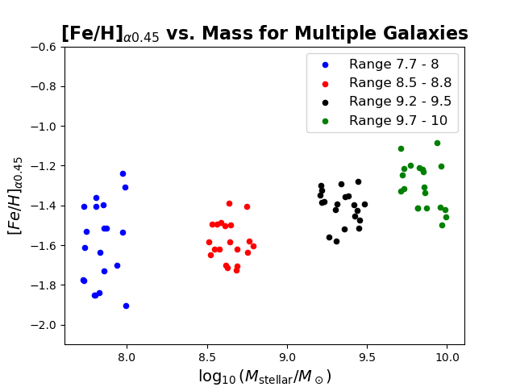
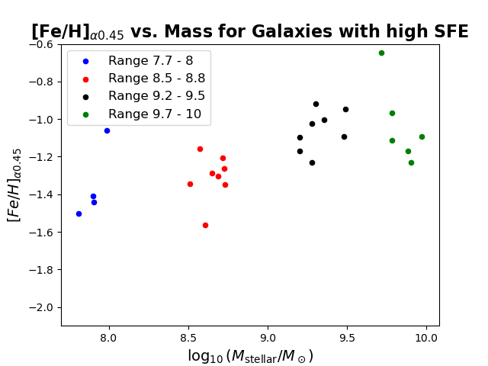
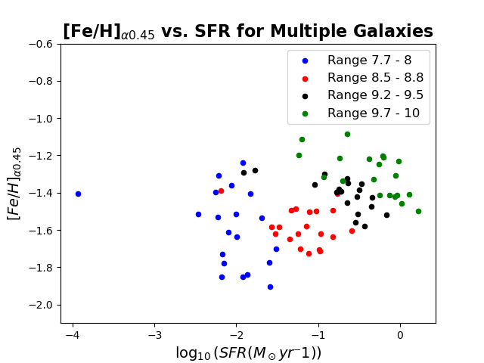
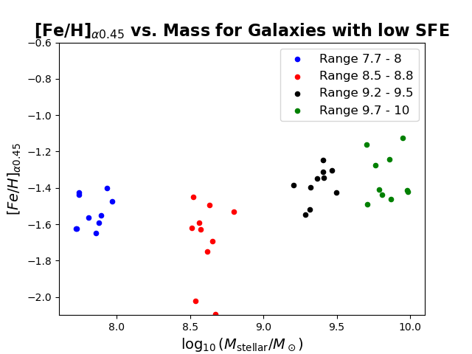
Correlations
Correlation between mass-metallicity and SFE-metallicity

Slide 10
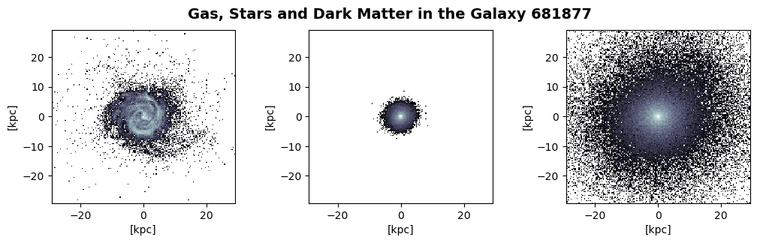
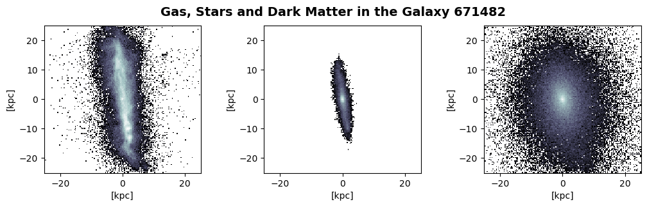
Comparison with LMC-type Galaxies
10^{9.2} M☉< Stellar Mass < 10^{9.6} M☉
0.005 Gyr⁻¹ < SFE < 0.015 Gyr⁻¹
[Fe/H] < -0.2

Slide 11
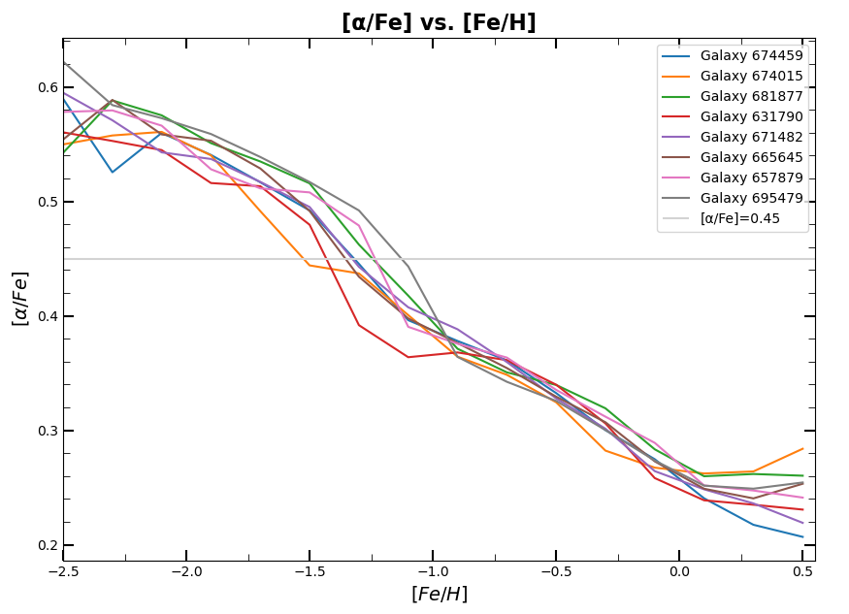

Methodology for Determining [Fe/H] and [α/Fe]
The value is taken from Asplund et al. (2021).

Slide 12
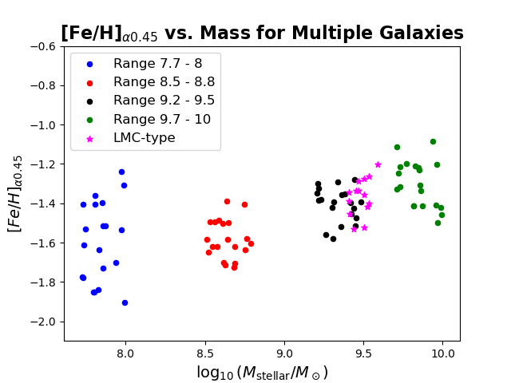
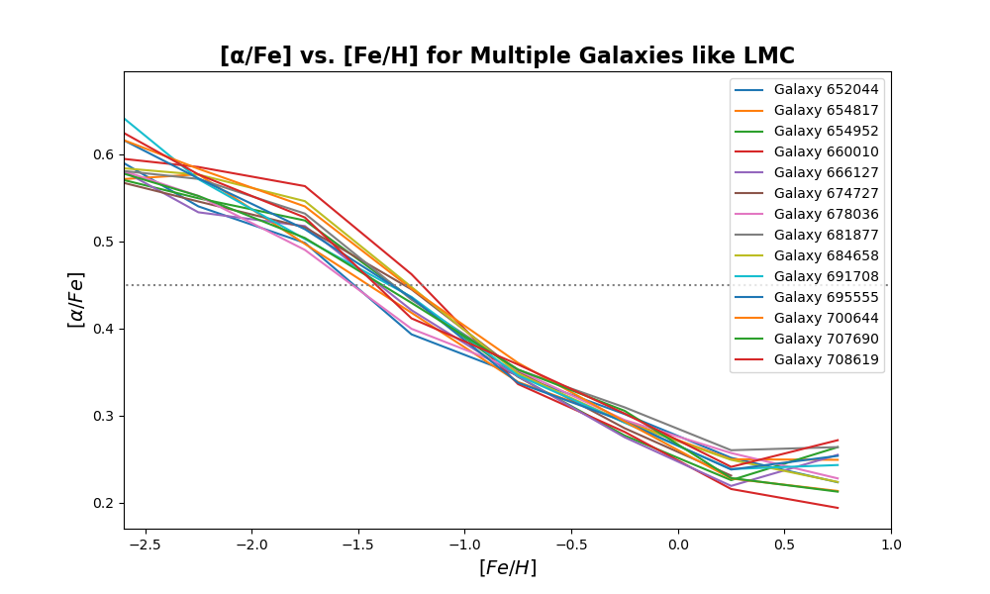
More precise restrictions for the searching of LMC-type Galaxies
Mass: (10^{9.4-9.6}M☉)
SFE: (10^{-11.1}yr⁻¹, 10^{-10.9}yr⁻¹)
Halo Mass: (10^{9-11.5}M☉)

Slide 13
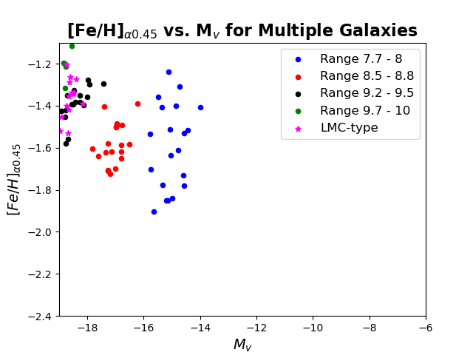
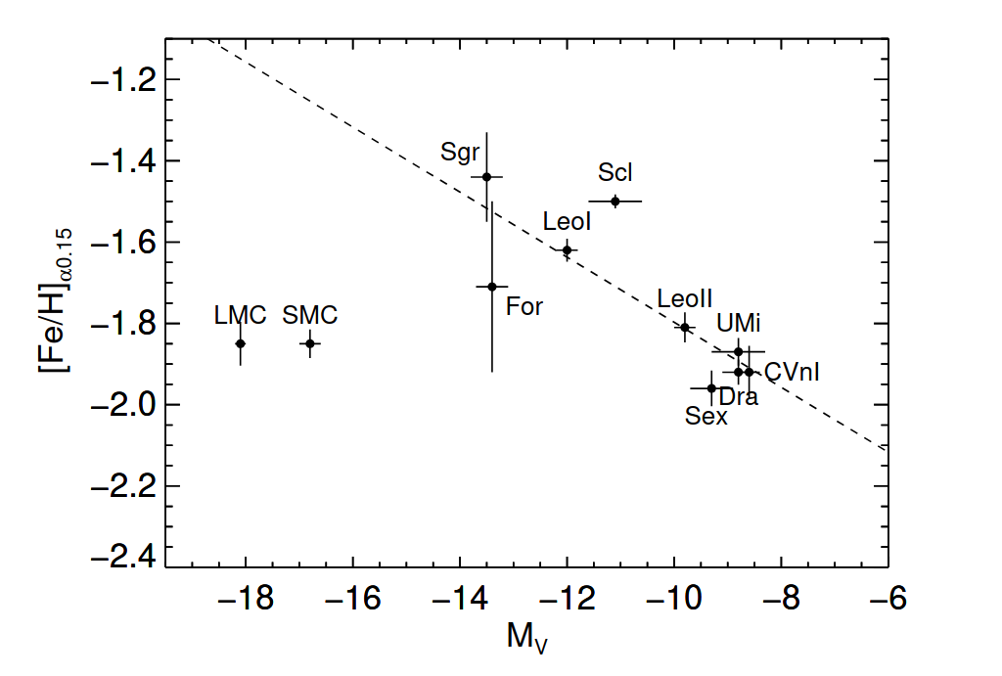
Comparison with the observations
Source: Nidever et al. (2020)
Figure: Comparison of the Metallicity with 𝛼0.15 and Mv of various Local Group galaxies

Slide 14
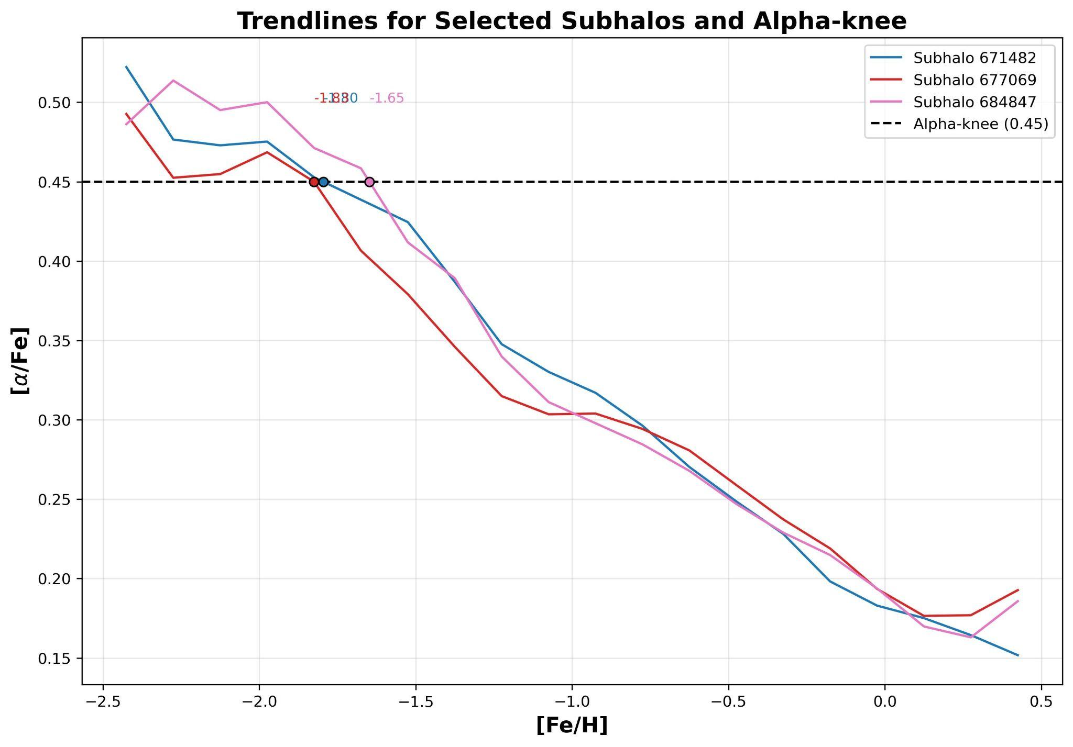
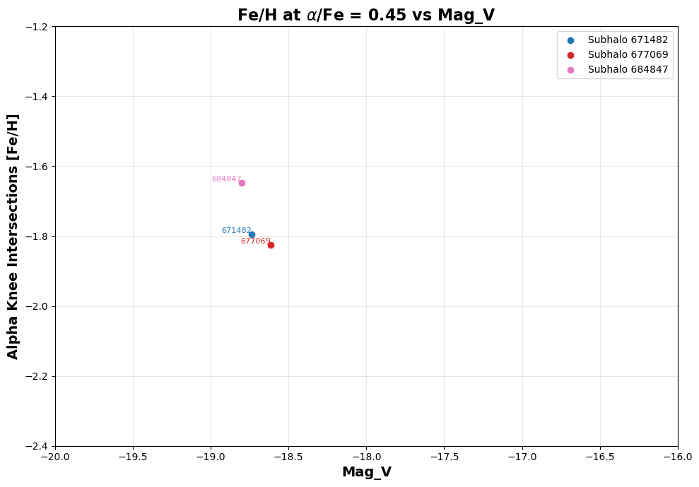
Another view for selecting LMC-type
Same conditions but selecting Central Galaxies only.
Sum of masses of all particles/cells (split by type) within twice the stellar half mass radius.

Slide 15
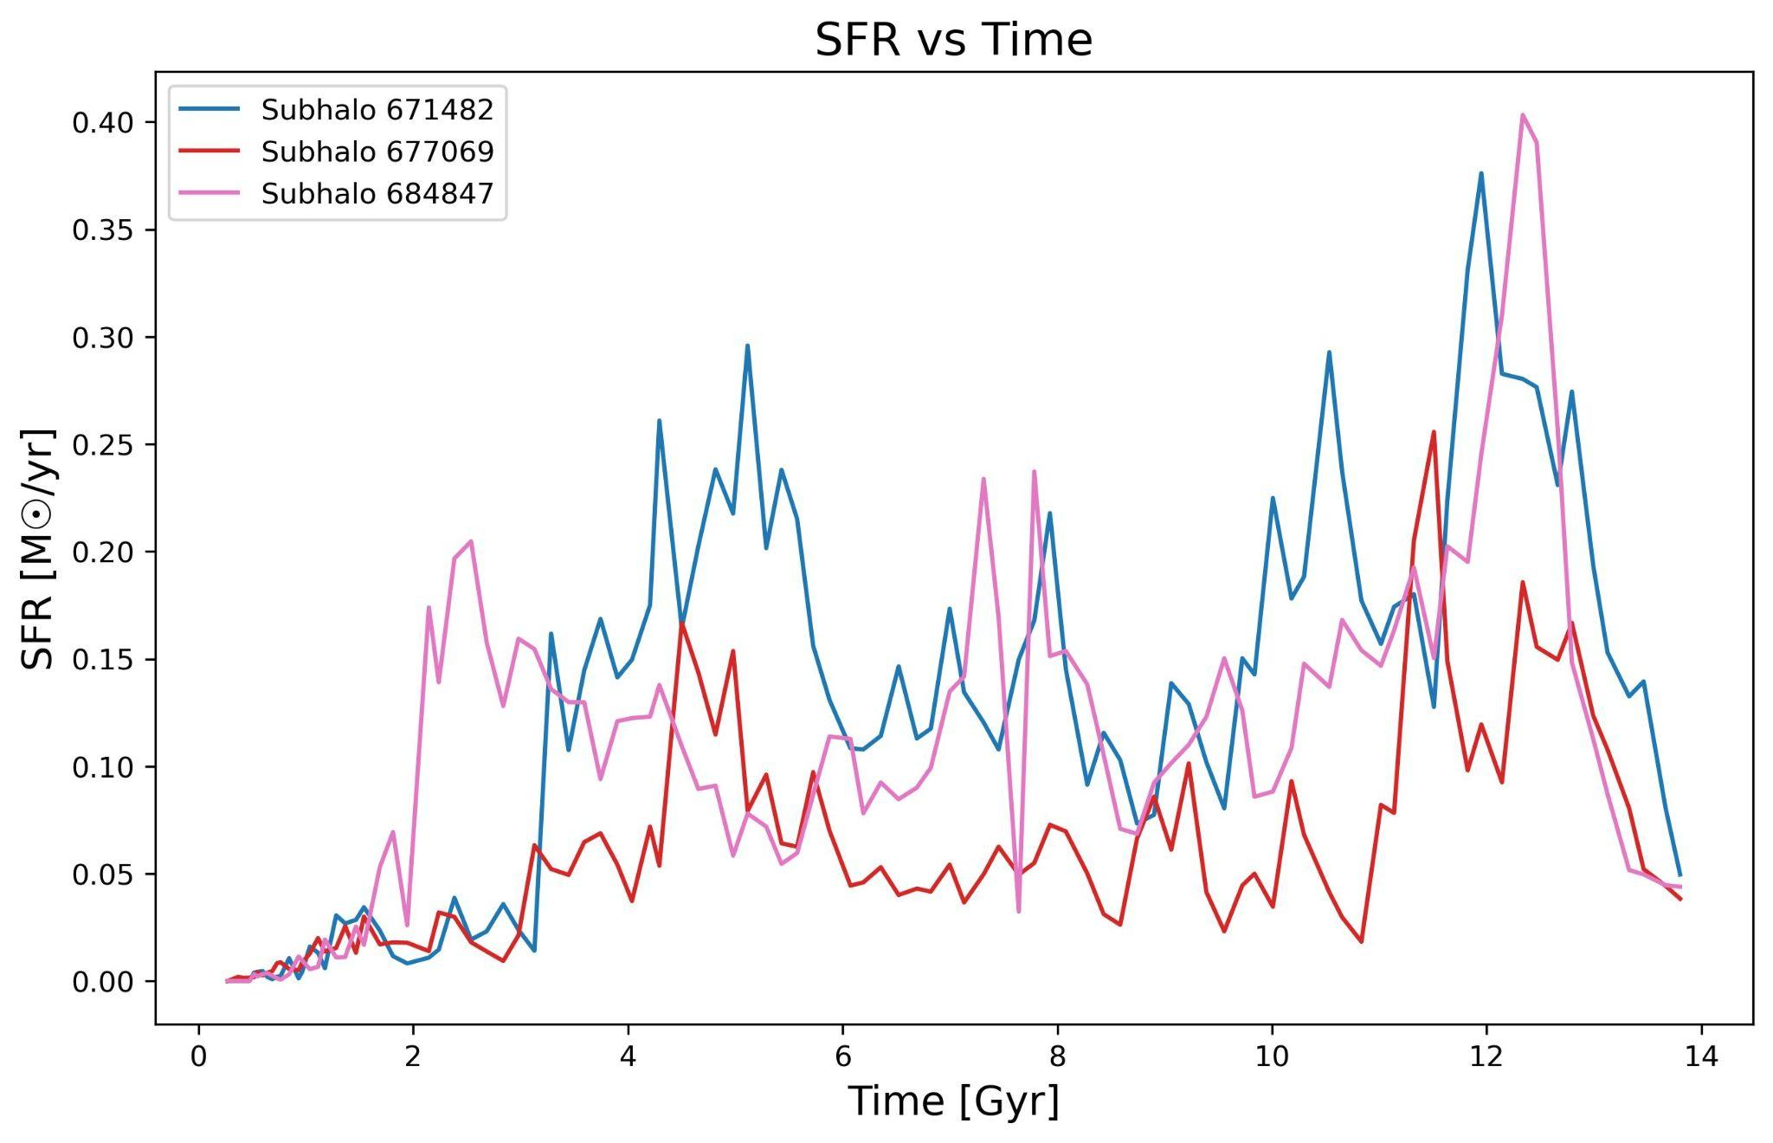
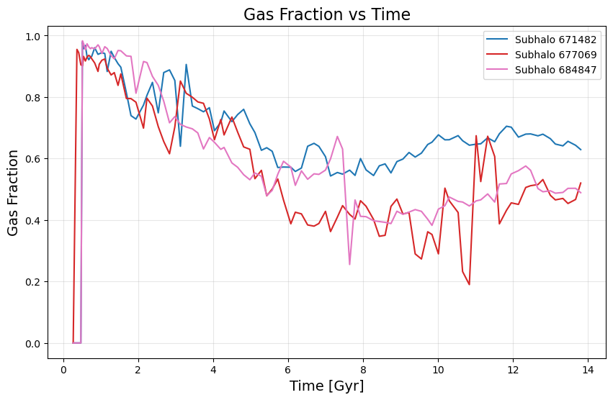
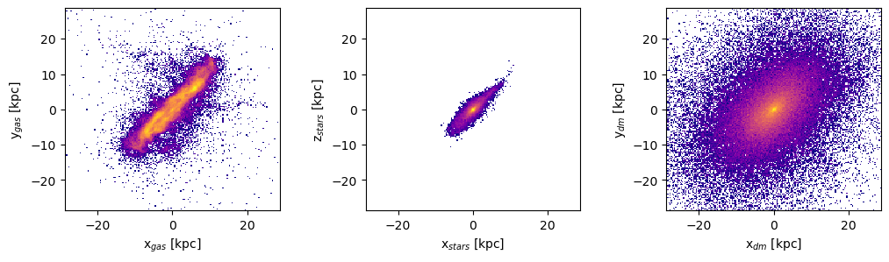
Evolution over time for SFR and Gas Fraction
ID galaxy: 677069

Slide 16
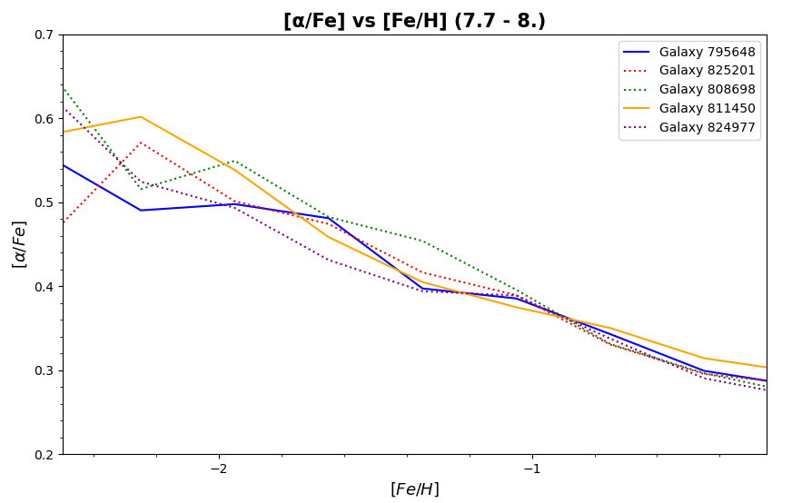
Galaxies like SMC (in a smaller range)
Properties | SMC | Galaxy 795087 | Galaxy 811450
Stellar Mass log(M⊙) | ~8.5 | ~ 9.1 | ~ 7.2
Maximum Stellar Metallicity [Fe/H] | -0.5 | ~ -0.4 | ~ -0.5
SFE (Gyr⁻¹) | ~0.01 | ~0.08 | ~0.01
Graphic of the selected galaxies similar to the SMC in the range 7.7 < log10(M⭑/M☉) > 8.0

Slide 17
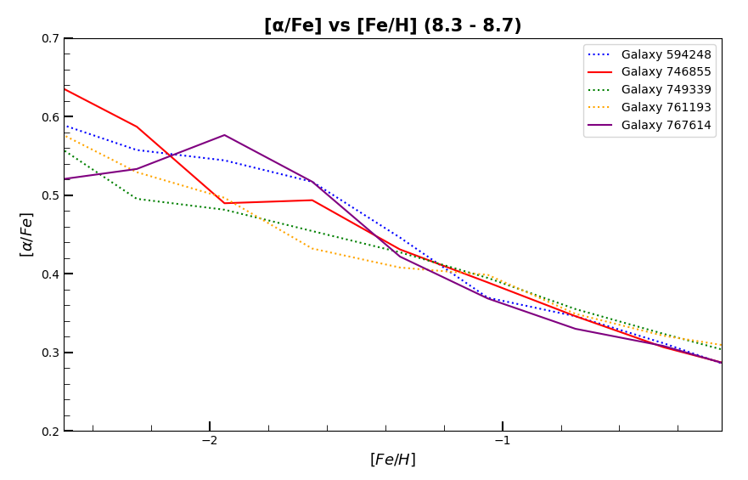
Galaxies like SMC (in a larger range)
Properties | SMC | Galaxy 746855 | Galaxy 767614
Stellar Mass log(M⊙) | ~8.5 | ~ 8.6 | ~8.3
Maximum Stellar Metallicity [Fe/H] | -0.5 | ~ -0.5 | ~ -0.5
SFE (Gyr⁻¹) | ~0.01 | ~0.02 | ~0.007
Graphic of the selected galaxies similar to the SMC in the range 8.3 < log10(M⋆/M☉) > 8.7

Slide 18
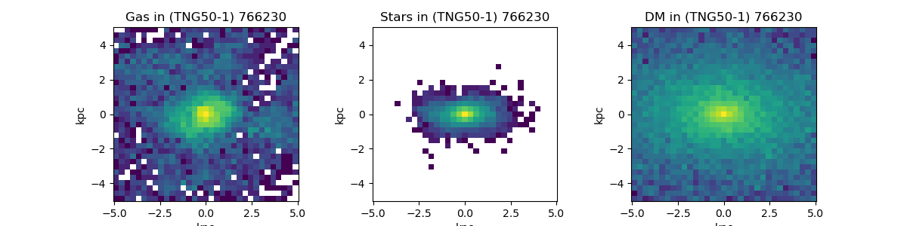
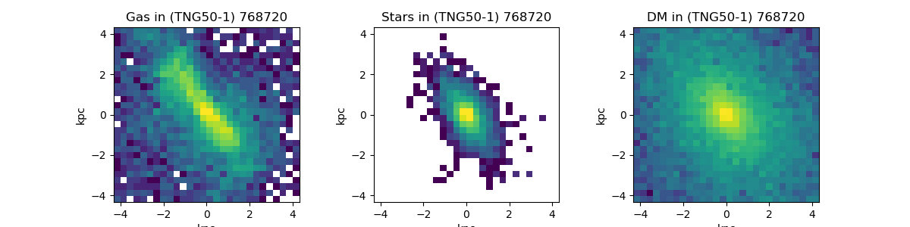
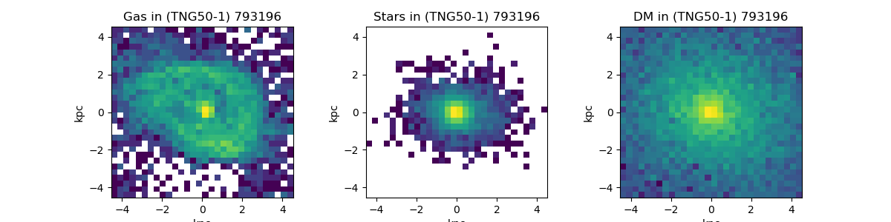
SMC-likes in TNG50
-Galaxies which resulted the most interesting among the candidates in the filter.
-The filter only allowing galaxies between a stellar mass of 8.495 and 8.505.
-It also restricts to galaxies with a low SFE, between 0.005 and 0.0015.
-They can give us a unique perspective to look at the SMC.

Slide 19
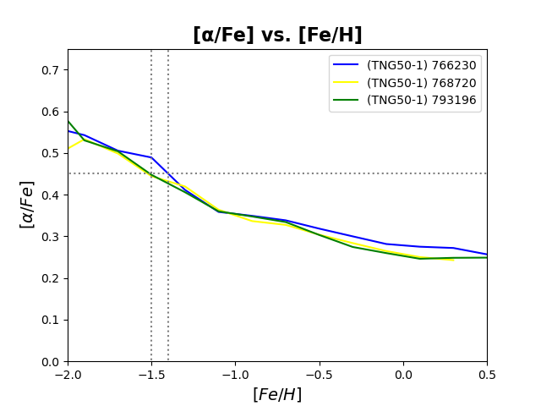
766230 and 793196
Two objects with very metal-poor knees, at ~-1.4 and ~-1.5
It has a similar absolute magnitude to the SMC’s -17. -17.17 and -16.77.
In visual terms, they present the expected shape of irregular galaxies such as the SMC.

Slide 20
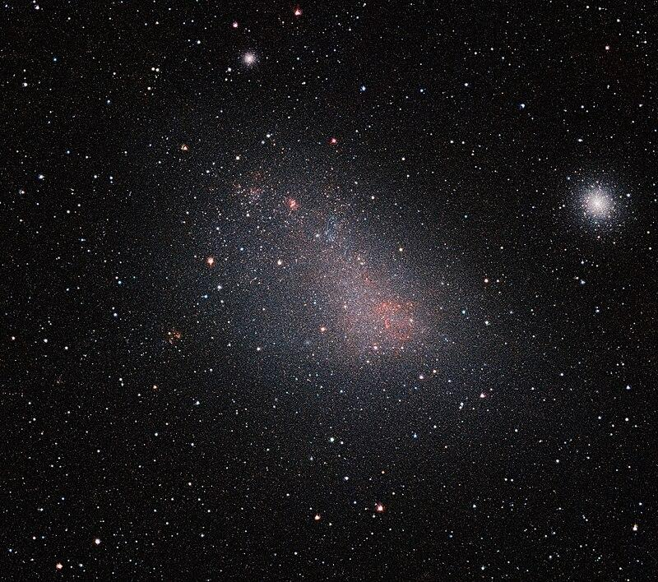
SMC’s ‘virtual twin’: 768720
Image taken by VISTA, operated by the ESO.
It looks very similar to the SMC in visual terms.
It has an absolute magnitude of -17.03, making it the closest to SMC’s -17
It shows a knee at -1.55 [Fe/H], making it the most metal-poor of the three.
In terms of size, it is close to the dimensions of the SMC.

Slide 21
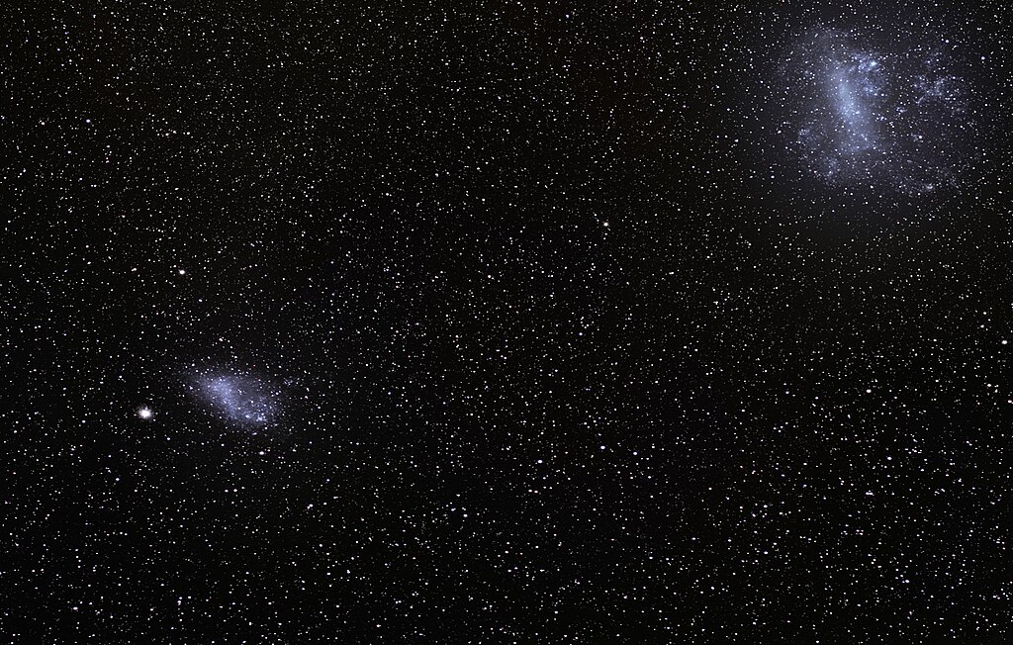
The hidden similarity within the three SMC-likes
Image taken by S. Bruiner, from the
ESO.
-These three SMC-likes share an important aspect: They are not satellite galaxies.
-The implicances of this information should be studied in-depth, as it could be an indicator of a trend in SMC-likes.

Slide 22
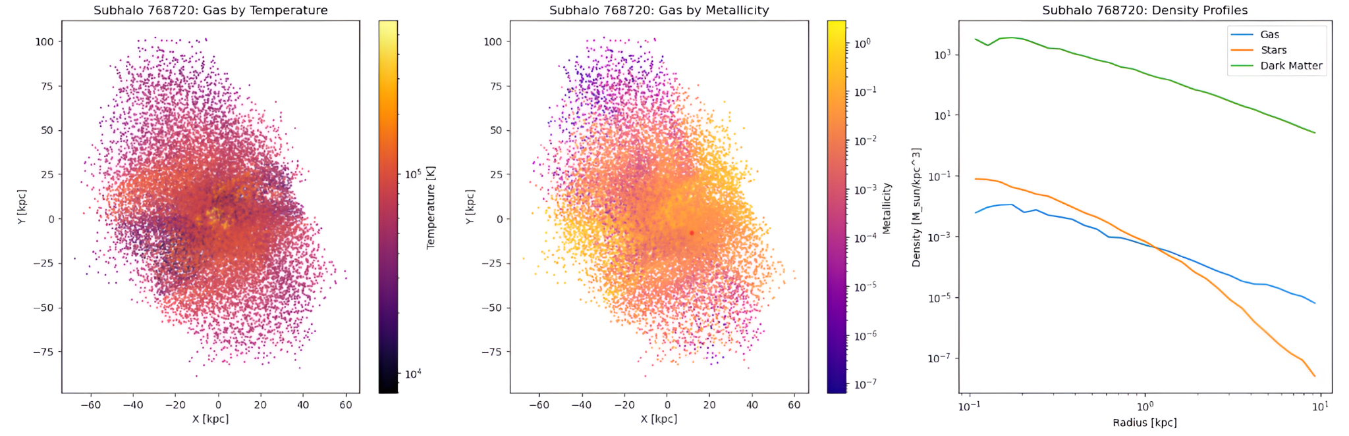




Galaxy 768720: Similar to SMC
Morphology:
- Irregular shape, similar to the SMC.
- Star formation concentrated in the central core.
Gas and Temperature:
- Hot gas: in the core.
- Cold gas: in the outskirts.
Metallicity:
- High in the core: .
- Low in the outer regions:
Density:
- Dominated by dark matter.
- Stars are concentrated, while gas is extended as a reservoir.

Slide 23
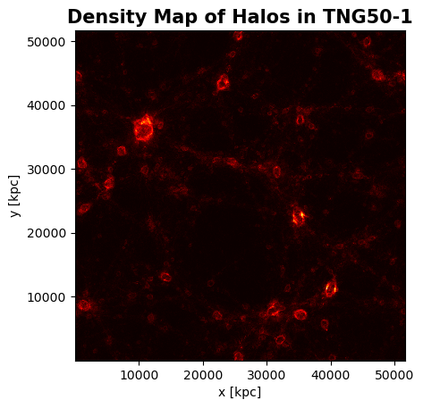
eli, galaxies like SMC (diferentes rango)
Satellite and Field Dwarf Galaxies
We can compare dwarf galaxies based on whether they are isolated or satellites of other galaxies, to do this we analyzed their stellar mass and the mass of their Halo

Slide 24
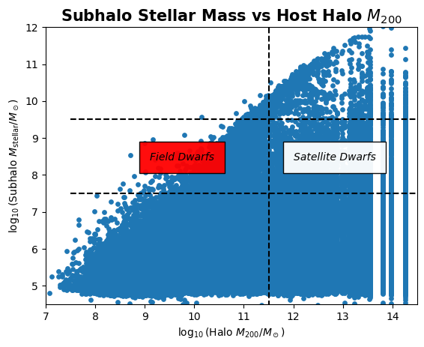
eli, galaxies like SMC (diferentes rango)

Slide 25
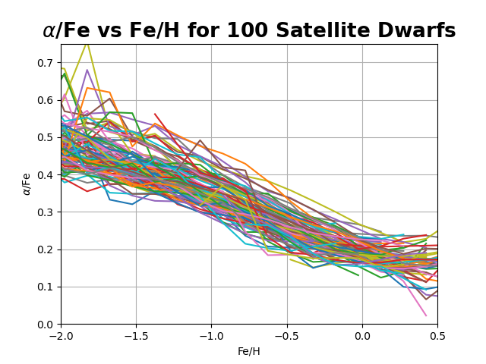
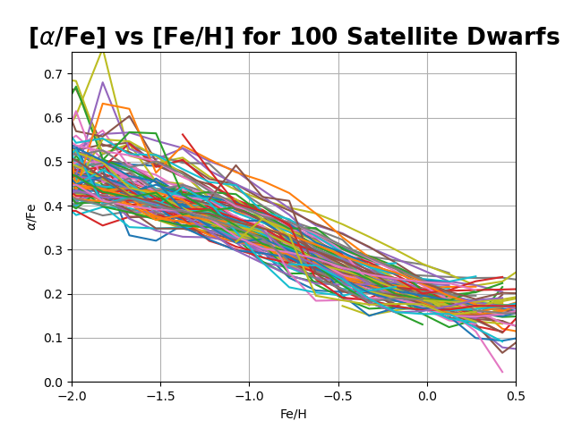
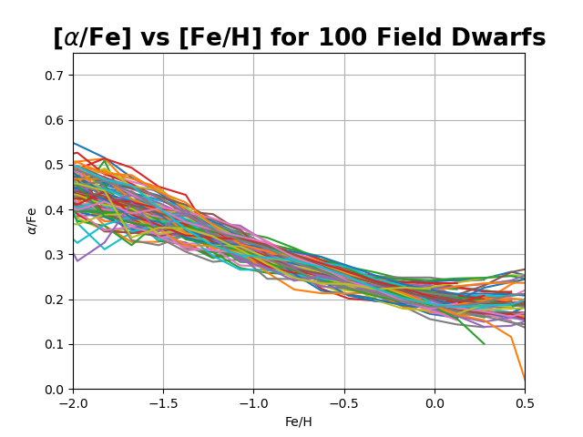
eli, galaxies like SMC (diferentes rango)

Slide 26
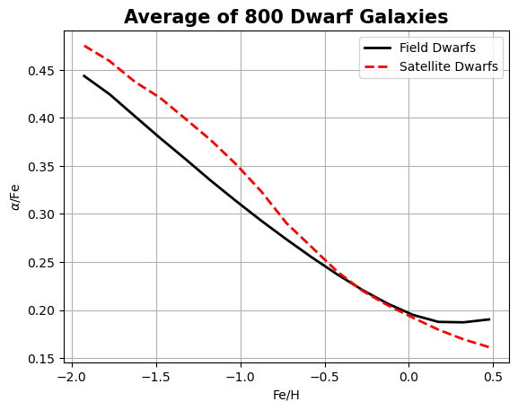

Slide 27
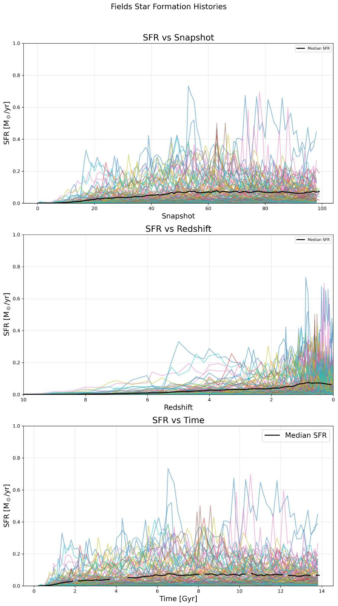
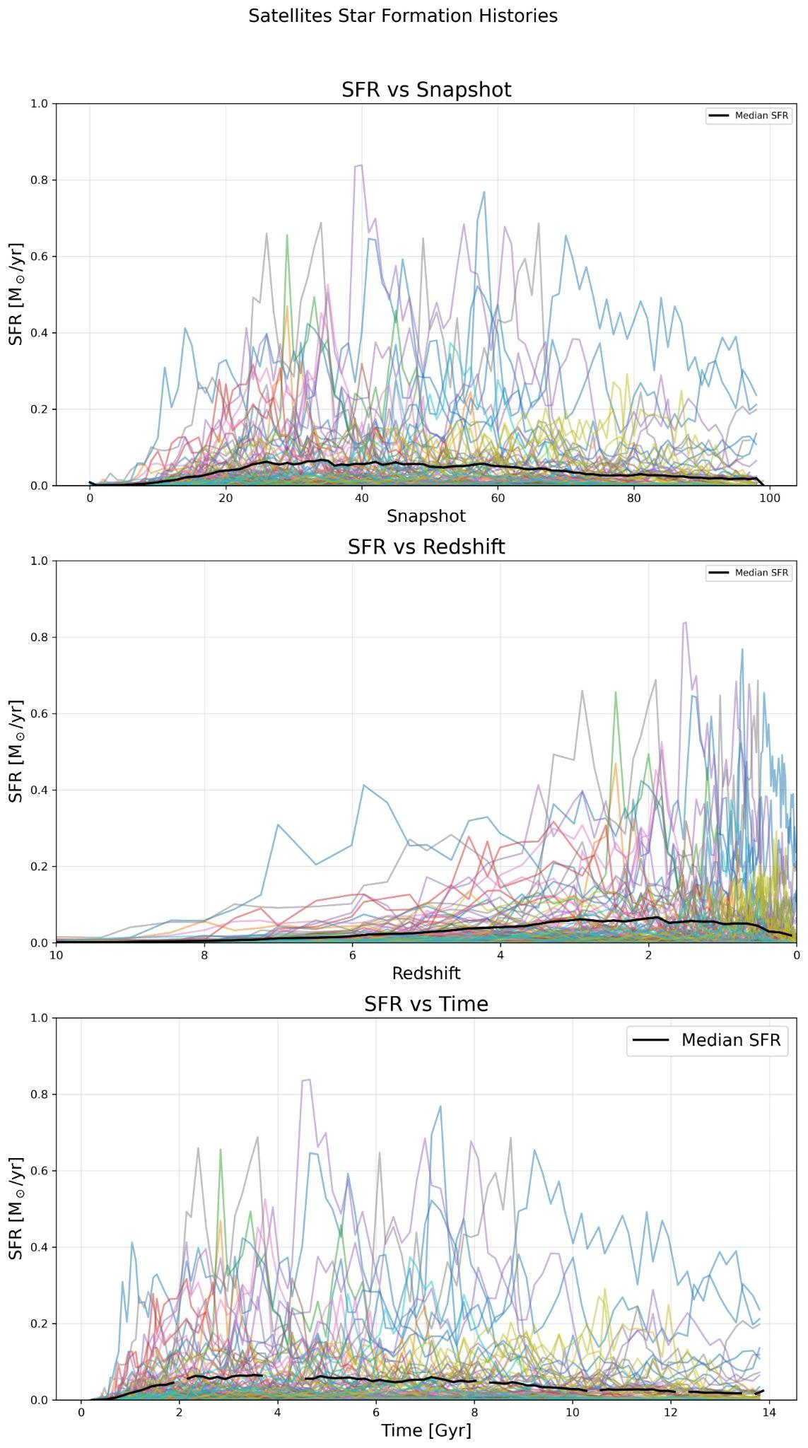


Slide 28
Final thoughts
-The proximity of dwarf galaxies to other galaxies changes the shape of the alpha-knee, because it affects star formation
-The lack of Alpha Abundance in the MCs might be because they’re new to the MW vicinity.

Slide 29

Next steps
Understand how, and if so, why the environment affects the evolution of dwarf galaxies, consider mechanisms such as ram pressure stripping and others that change morphology and chemistry in different regimes, and improve our filter selection and compare with other works.
Source: V. Belokurov, D. Erkal, A. Mellinger

Slide 30
References
Asplund, M., Amarsi, A. M., & Grevesse, N. (2021). The chemical make-up of the Sun: A 2020 vision. Astronomy & Astrophysics, 653, A141.
Bhattacharyya, J., Peter, A. H., & Leauthaud, A. (2025). Dwarf Galaxies in the TNG50 Field: connecting their Star-formation Rates with their Environments. arXiv preprint arXiv:2501.01946.
IllustrisTNG Project, https://www.tng-project.org/about/
Nidever, D. L., Hasselquist, S., Hayes, C. R., Hawkins, K., Povick, J., Majewski, S. R., ... & Rosado, M. (2020). The lazy giants: APOGEE abundances reveal low star formation efficiencies in the Magellanic Clouds. The Astrophysical Journal, 895(2), 88.
Shipp, N., Erkal, D., Drlica-Wagner, A., Li, T. S., Pace, A. B., Koposov, S. E., ... & S 5 Collaboration. (2021). Measuring the mass of the Large Magellanic Cloud with stellar streams observed by S 5. The Astrophysical Journal, 923(2), 149.

